Slide 1

Department of Computer Science & Engineering
2024-25
Game’s Using Quantum Computing
Batch Number: B1
by,
3VC21CS091: M Srinivas Reddy
3VC21CS077: K Sree Deepa
Under the guidance of,
LINGARAJ K,
Assistant Professor,
Department of CSE,
RYMEC

Slide 2
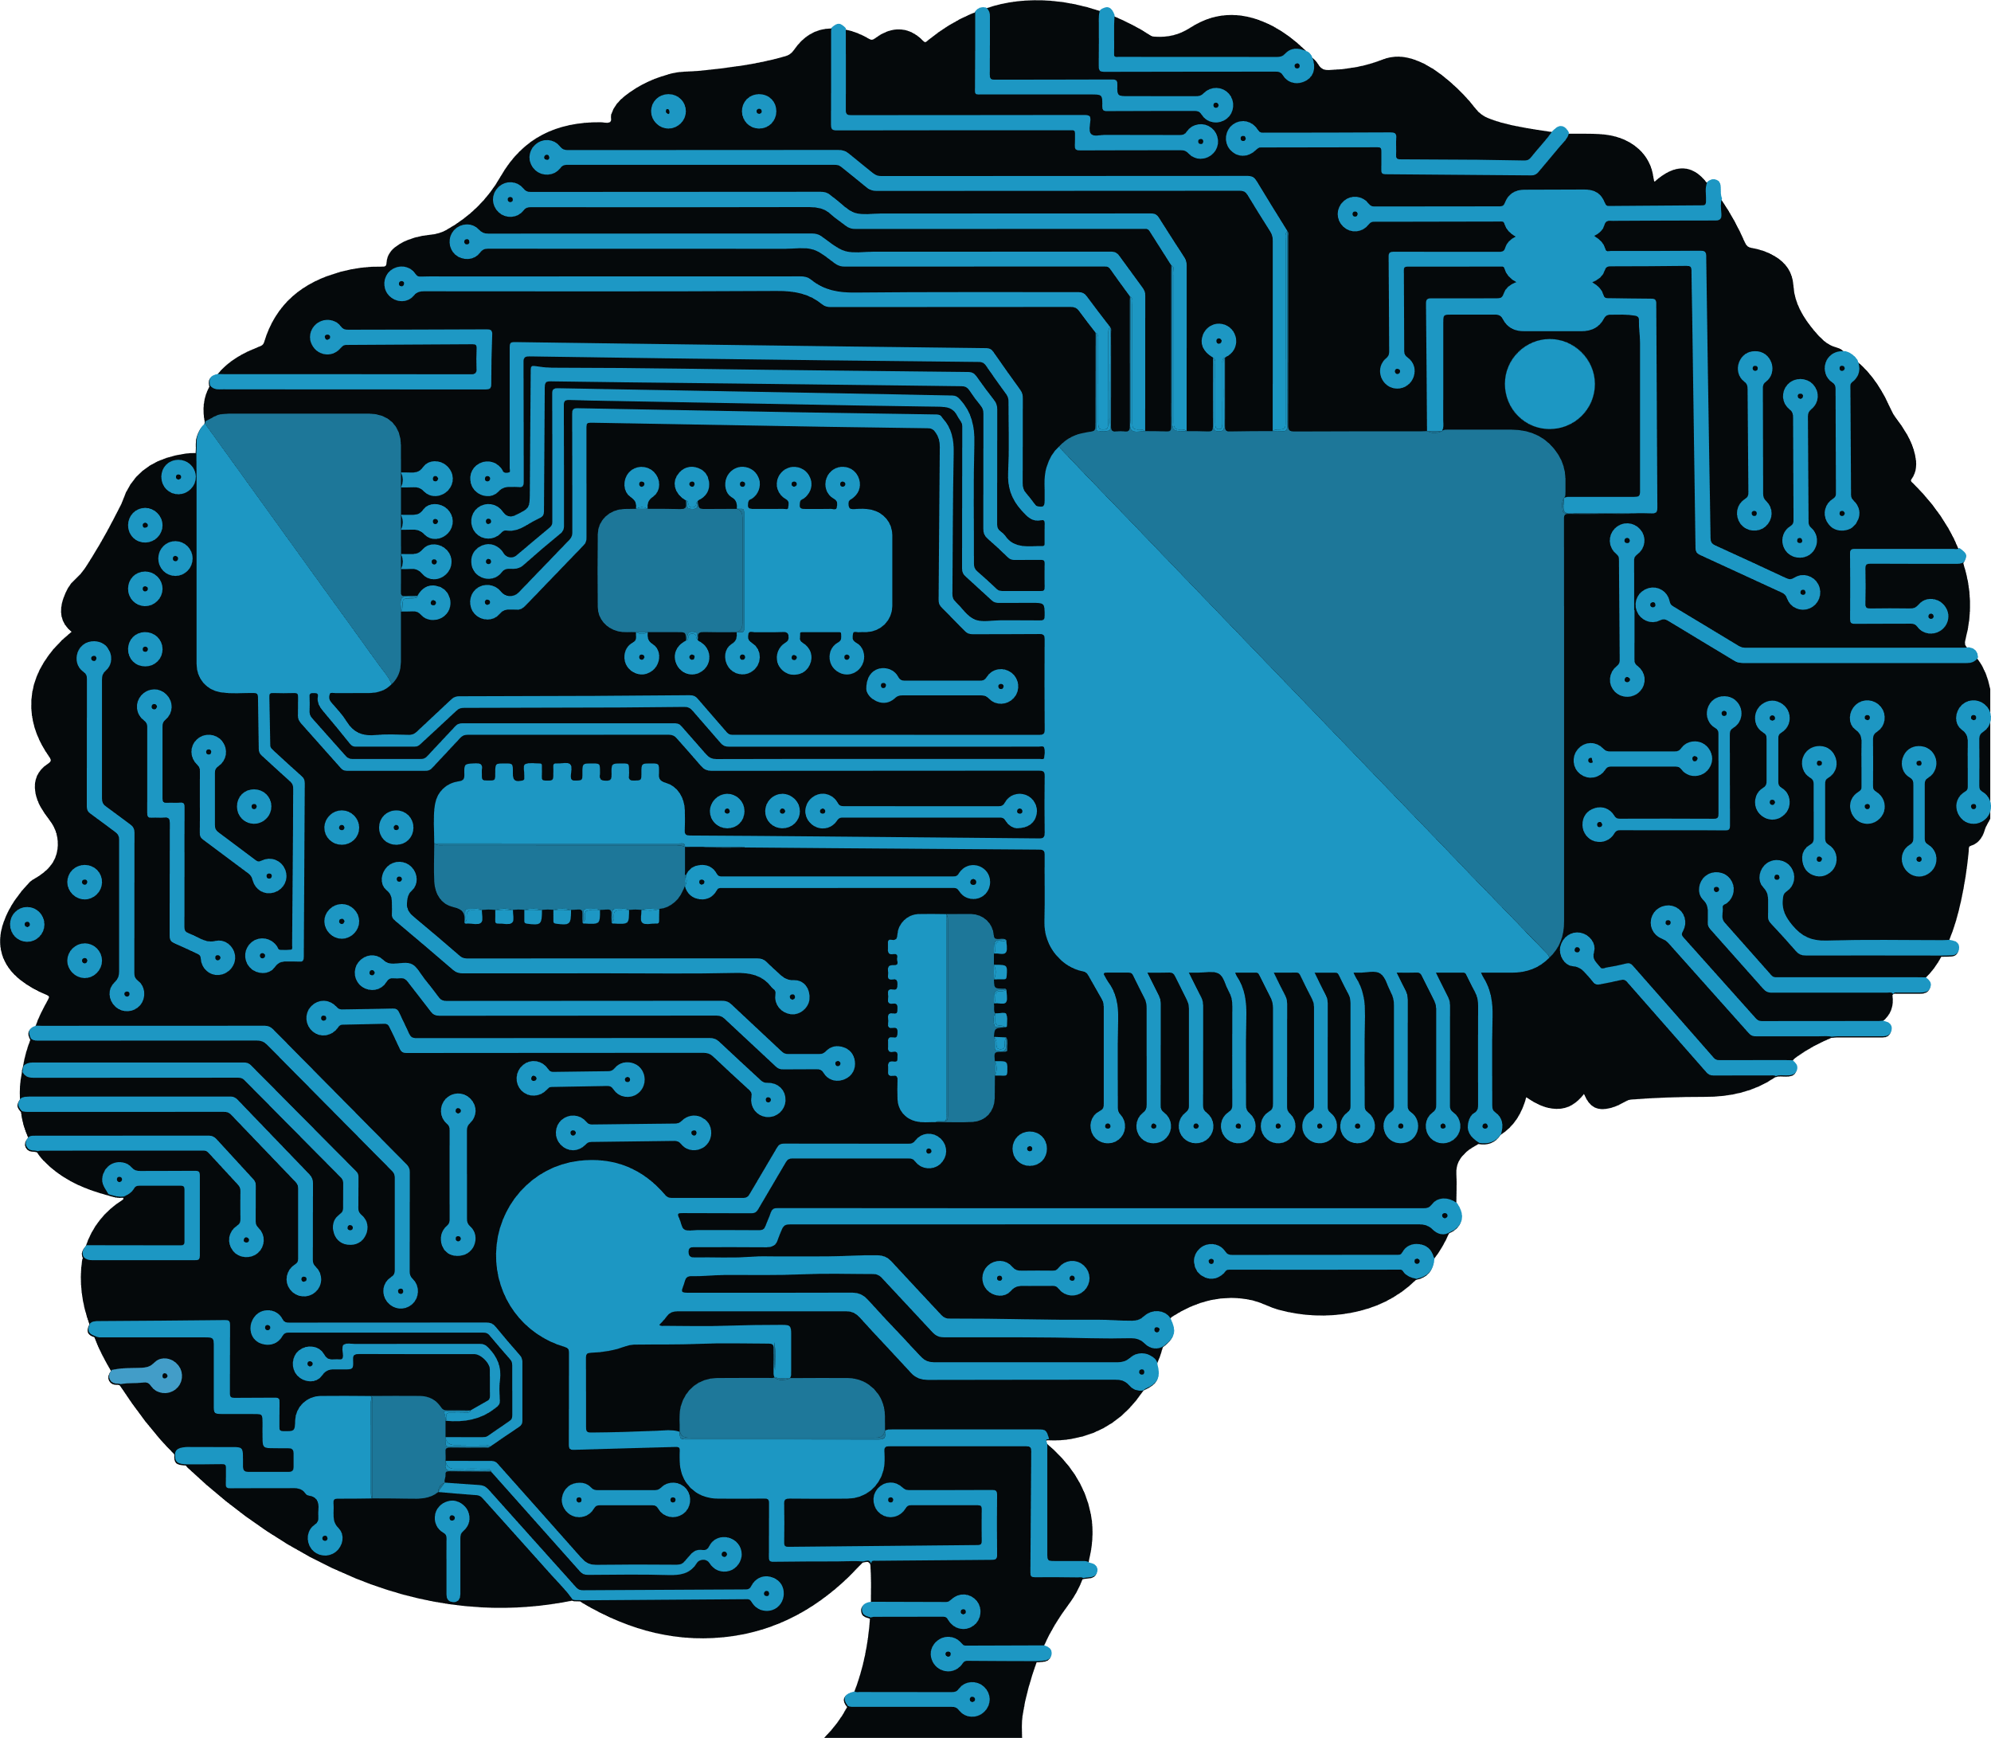
Quantum
Computing
Games
Quantum Computer
A computer that uses laws of quantum mechanics to perform massively parallel computing through superposition, entanglement, and decoherence.
Classical Computer
A computer that uses voltages flowing through circuits and gates, which can be controlled and manipulated entirely by classical mechanics.
Department .of Computer Science, RYMEC, Ballari

Slide 3
Classical Bit vs. Quantum Bit
QUANTUM BITS:
can be in state |0> or in state |1> or in any other state that is a linear combination of the two states
can be measured partially with given probability
are changed by measurement
cannot be copied
cannot be erased
CLASSICAL BITS:
can be in two distinct states, 0 and 1
can be measured completely
are not changed by measurement
can be copied
can be erased
Department .of Computer Science, RYMEC, Ballari

Slide 4
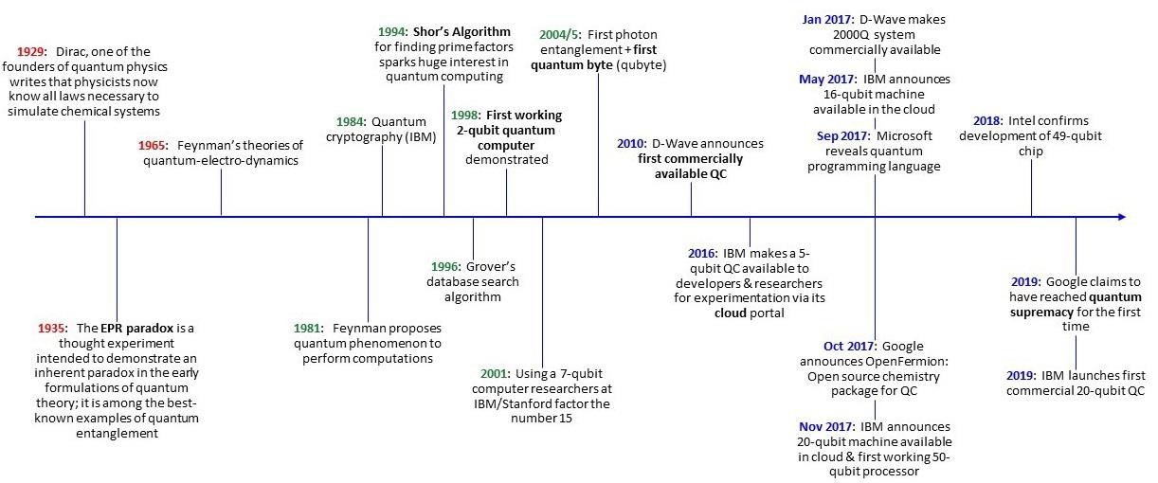
Evolution of Quantum Theory & Quantum Technology
The Foundations
From Theory to Practice
Commercialization & Application
2020: Chinese scientists claimed 100 trillion faster of quantum supremacy
1980
2010
1900’s
2021
1925: Schrödinger Equation proposed
Department .of Computer Science, RYMEC, Ballari
8

Slide 5
Brief History of Quantum Computers
1981: Richard Feynman proposed to use quantum computing to model quantum systems. He also describe theoretical model of quantum computer
1985: David Deutsch described first universal quantum computer
1994: Peter Shor developed the first algorithm for quantum computer (factorization into primes)
1995 Schumacher proposed “Quantum bit” or “qubit” as physical resource
1996: Lov Grover developed an algorithm for search in unsorted database
1998: the first quantum computers on two qubits, based on NMR (Oxford; IBM, MIT, Stanford)
2000: quantum computer on 7 qubits, based on NMR (Los-Alamos)
2001: 15 = 3 x 5 on 7- qubit quantum computer by IBM
2005-2006: experiments with photons; quantum dots; fullerenes and nanotubes as "particle traps"
Department .of Computer Science, RYMEC, Ballari

Slide 6
Brief History of Quantum Computers
2007: D-Wave announced the creation of a quantum computer on 16 qubits
2012: D-Wave claimed a quantum computation using 84 qubits
2017: D-Wave Systems Inc. announced the D-Wave 2000Q quantum annealer with 2000 qubits
2017: Microsoft revealed Q Sharp with 32 qubits
2018: Google announced the creation of a 72-qubit quantum chip
2019: Google claimed quantum supremacy with 54 qubits to perform operations in 200
seconds that would take a supercomputer about 10,000 years to complete
2019: IBM revealed 53 qubits
2020: Chinese researchers claimed to have achieved quantum supremacy using a photonic 76-
qubit system at 100 trillion times the speed of classical supercomputers
2020: IBM will build 1121-qubit quantum computer in 2023, and 1 million-qubit quantum computer in 2030.
Department .of Computer Science, RYMEC, Ballari

Slide 7
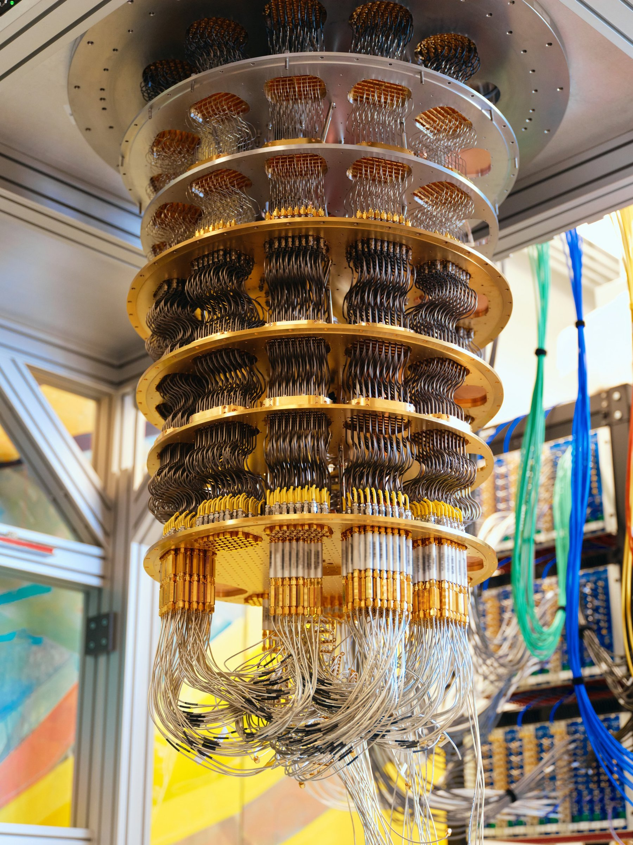
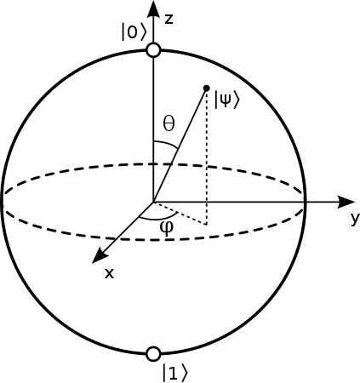
Qubits
Classical bits are either 0 or 1, quantum bits have been described as being 0 and 1
A more mathematical definition would be that the condition of n qubits is like a vector in a 2^{n} dimensional Hilbert space
Department .of Computer Science, RYMEC, Ballari

Slide 8
Why Quantum?
Because quantum solutions perform better at certain tasks
Quantum Superposition
Quantum Entanglement
Qubits scale exponentially (2^{n})
Quantum algorithms
Moore's Law failing, Neven's law succeeding
Success of Rose's Law
Quantum solutions scale much more easily
Amount of data is increasing exponentially, classical algorithms cannot keep up
Department .of Computer Science, RYMEC, Ballari

Slide 9
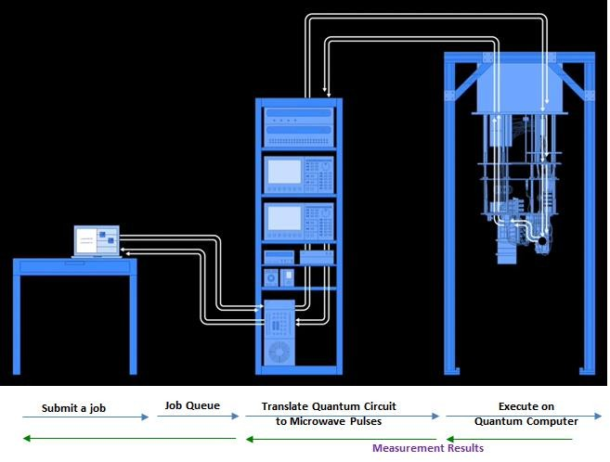
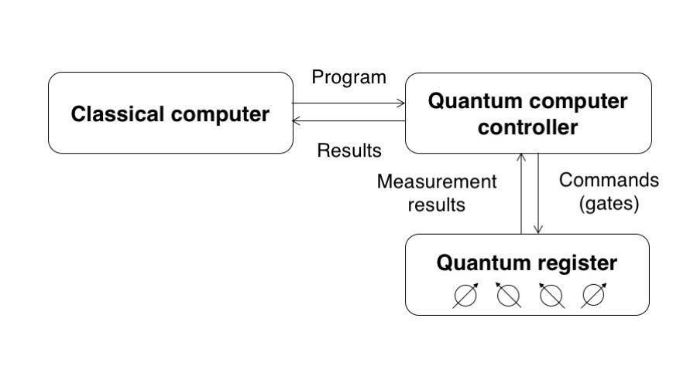
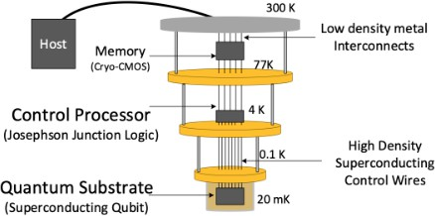

How does a quantum computer work?
Quantum Computer Architecture
cloud
The flow of submitting a job from a classical computer to a quantum computer, executing the job, and returning quantum measurement results to the classical computer.
Department .of Computer Science, RYMEC, Ballari

Slide 10
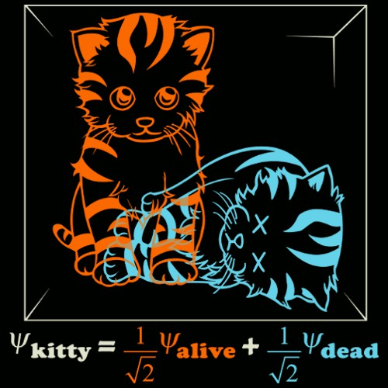
Superposition
Every quantum state can be represented as a sum of two or more other distinct states.
Mathematically, it refers to a property of solutions to the Schrödinger equation; since the Schrödinger equation is linear, any linear combination of solutions will also be a solution.
A single qubit can be forced into a superposition of the two states denoted by the addition of the state vectors:
|ψ> = α₀ |0> + α₁ |1>
Where α₀ and α₁ are complex numbers and |α₀ |² + | α₁|² = 1
A qubit in superposition is in both of the states |1> and |0 at the same time
If this state is measured, we see only one or the other state (live or dead) with some probability.
The classic example of superposition is Schrödinger’s Cat in a black box. Since both a living and
dead cat are obviously valid solutions to the laws of quantum mechanics, a superposition of the
two should also be valid. Schrödinger described a thought experiment that could give rise to
such a state.
Consider a 3-qubit register. An equally weighted superposition of all possible states would be denoted by:
|ψ> = 1 |000> + 1 |001> + . . . + 1 |111>
24
√8
√8
√8
Department .of Computer Science, RYMEC, Ballari

Slide 11
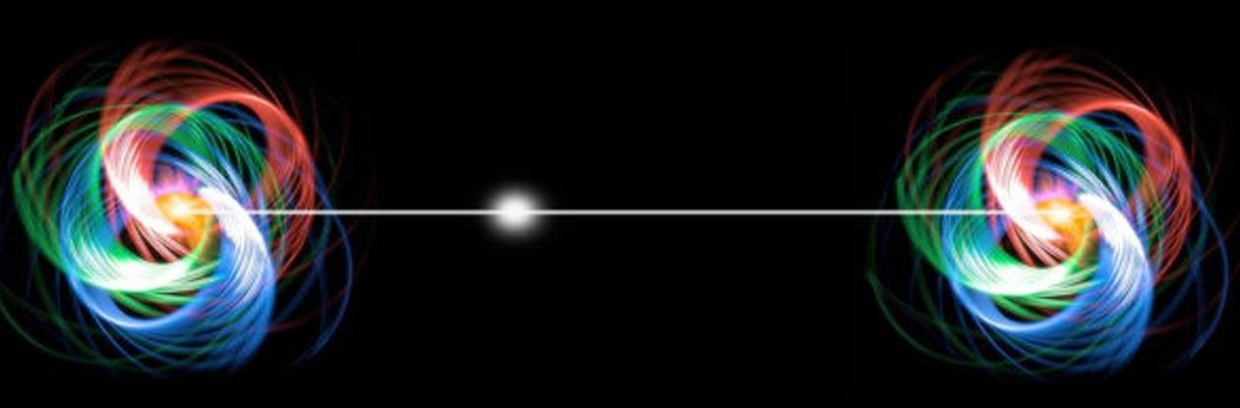
Entanglement
When a pair or group of particles is generated, interact, or share spatial proximity in a way such that the quantum state of each particle of the pair or group cannot be described independently of the state of the others, even when the particles are separated by a large distance.
An entangled pair is a single quantum system in a superposition of equally possible states. The entangled state contains no information about the individual particles, only that they are in opposite states.
If the state of one is changed, the state of the other is instantly adjusted to be consistent with
quantum mechanical rules.
If a measurement is made on one, the other will automatically collapse.
Quantum entanglement is at the heart of the disparity between classical and quantum physics:
entanglement is a primary feature of quantum mechanics lacking in classical mechanics.
Entanglement is a joint characteristic of two or more quantum particles.
Einstein called it “spooky actions at a distance”
Department .of Computer Science, RYMEC, Ballari

Slide 12
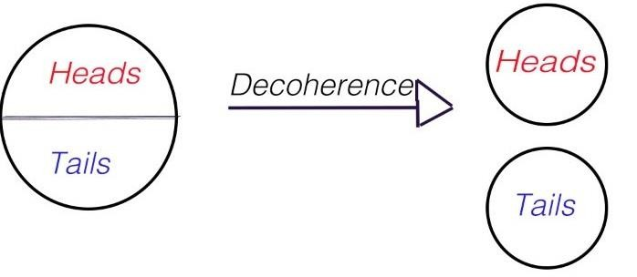
Decoherence
Quantum decoherence is the loss of superposition, because of the spontaneous interaction between a quantum system and its environment.
Decoherence can be viewed as the loss of information from a system into the environment.
The reason why quantum computers still have a long way to go because superposition and entanglement are extremely fragile states.
Preventing decoherence remains the biggest challenge in building quantum computers.
Department .of Computer Science, RYMEC, Ballari

Slide 13
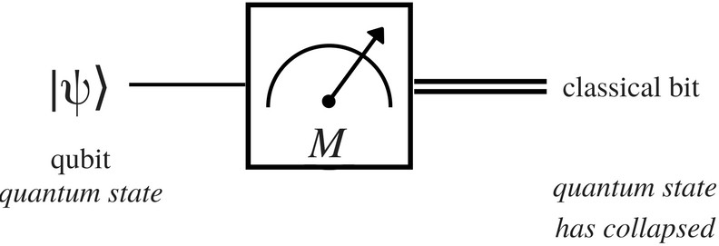
Measurement
If a quantum system were perfectly isolated, it would maintain coherence indefinitely, but it would be impossible to manipulate or investigate it.
A quantum measure is a decoherence process.
When a quantum system is measured, the wave function |ψ⟩ collapses to a new state according to a probabilistic rule.
If |ψ> = α₀ |0> + α₁ |1>, after measurement, either |ψ⟩ = |0⟩ or |ψ⟩ = |1⟩, and these alternatives occur with certain probabilities of |α₀|² and |α₁|² with |α₀|² + |α₁|² =1.
A quantum measurement never produces |ψ⟩ = α₀ |0> + α₁ |1>.
Example: Two qubits:|ψ> = 0.316|00›+0.447|01›+0.548|10›+0.632|11› The probability to read the rightmost bit as 0 is |0.316|²+ |0.548|²= 0.4
Department .of Computer Science, RYMEC, Ballari

Slide 14
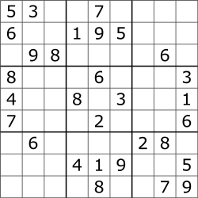
The problem - Sudoku
It's a combinatorial, number placing puzzle
The objective is to place numbers from 1 through 9, exactly once in each column, row and 3x3 subgrid
Gets easier as the number of digits already filled increases
Department .of Computer Science, RYMEC, Ballari

Slide 15
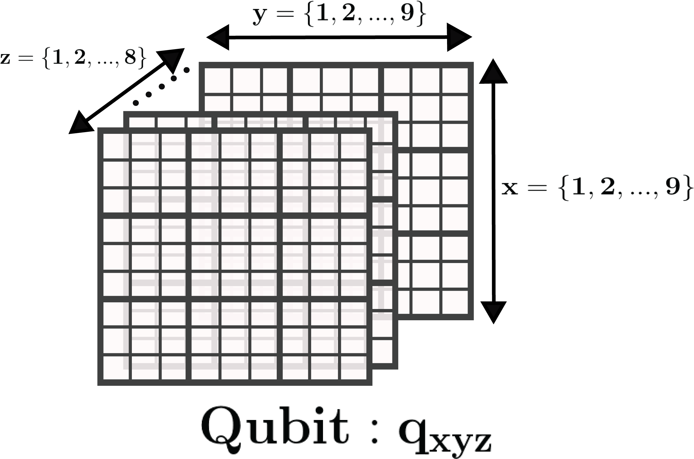
Qubit modelling
Each square has one digit from 1 through 9. We model those 9 numbers with 8 qubits. (call it an 8-group) This can be called 'one-hot and zero' encoding
That makes 648 such qubits
Department .of Computer Science, RYMEC, Ballari

Slide 16
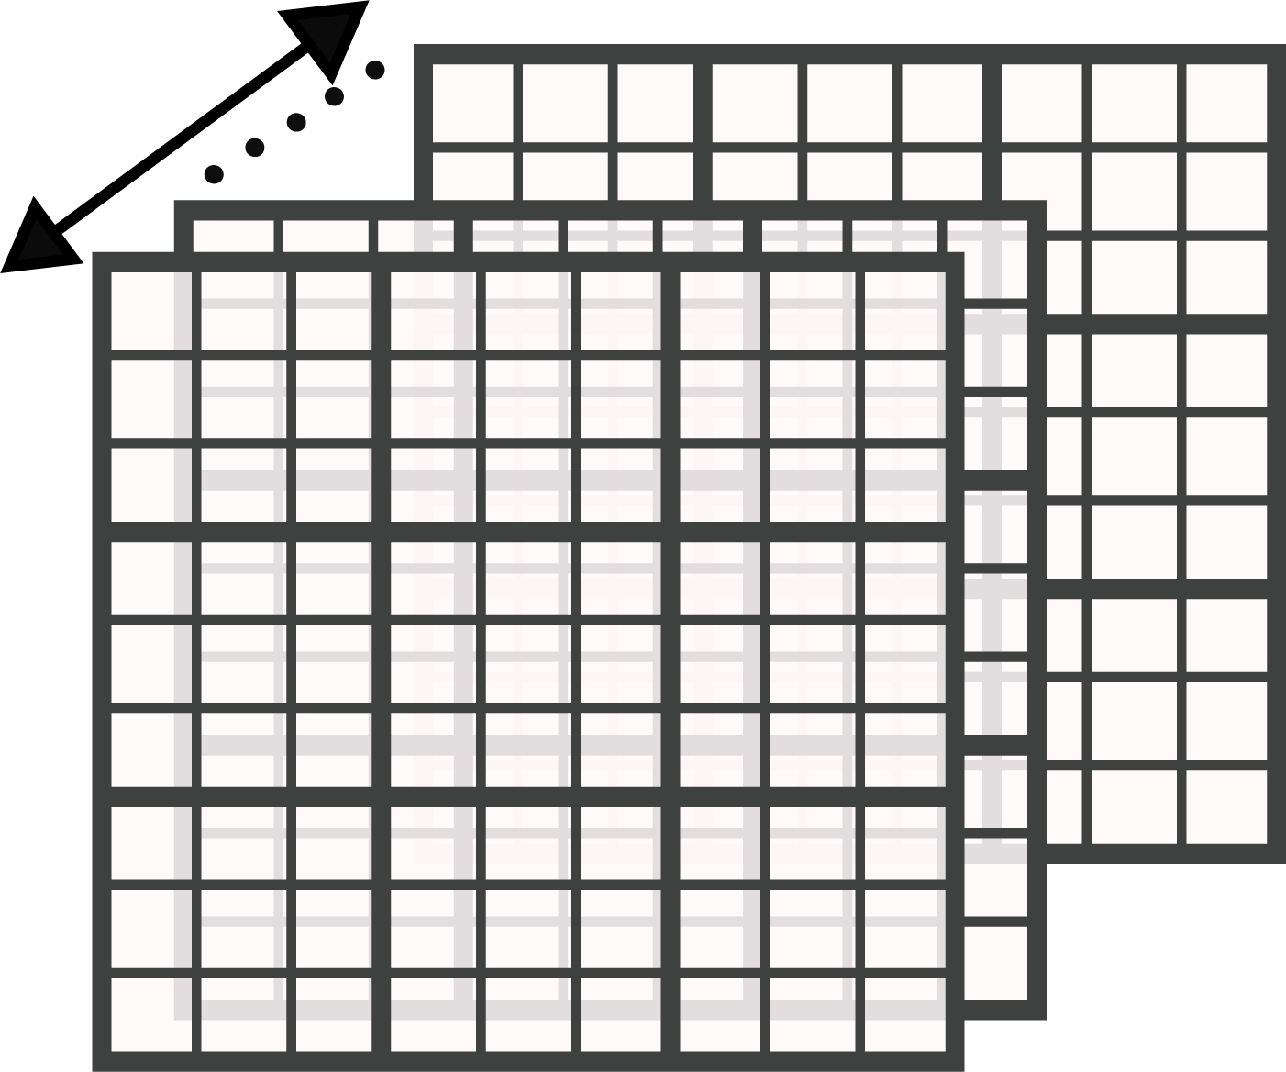
Constraints
1. Each 8-group should have at most one qubit in the '1' state, all the others in '0' state 2. Each row has all 9 digits appearing only once 3. Each column has all 9 digits appearing only once 4. Each 3x3 subgrid has all 9 digits appearing only once
Department .of Computer Science, RYMEC, Ballari

Slide 17
Solution Presented
Initialize and Set Up the Sudoku Game
Validate Player Moves
Map Player Moves to Quantum Circuit
Implement Undo Functionality
Check for Completed Sub-Grids (Boxes)
Track Player Progress
Combine Quantum Circuits
Validate and Analyze the Solution
High level Algorithm for our solution
Department .of Computer Science, RYMEC, Ballari

Slide 18

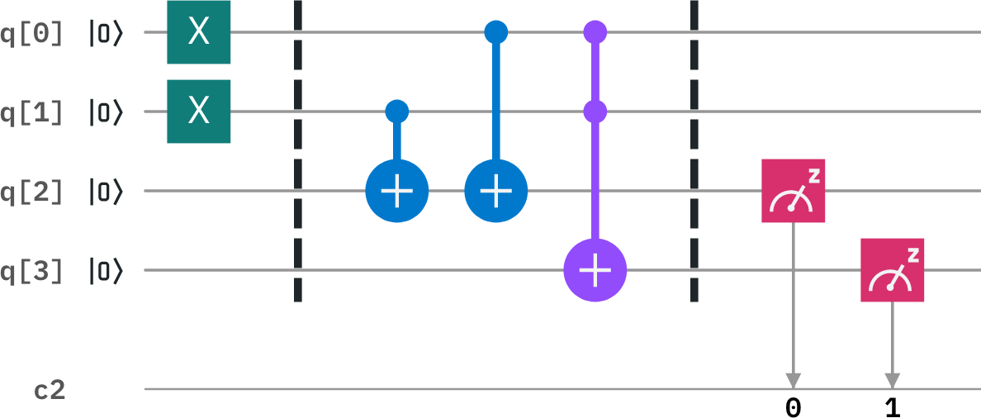
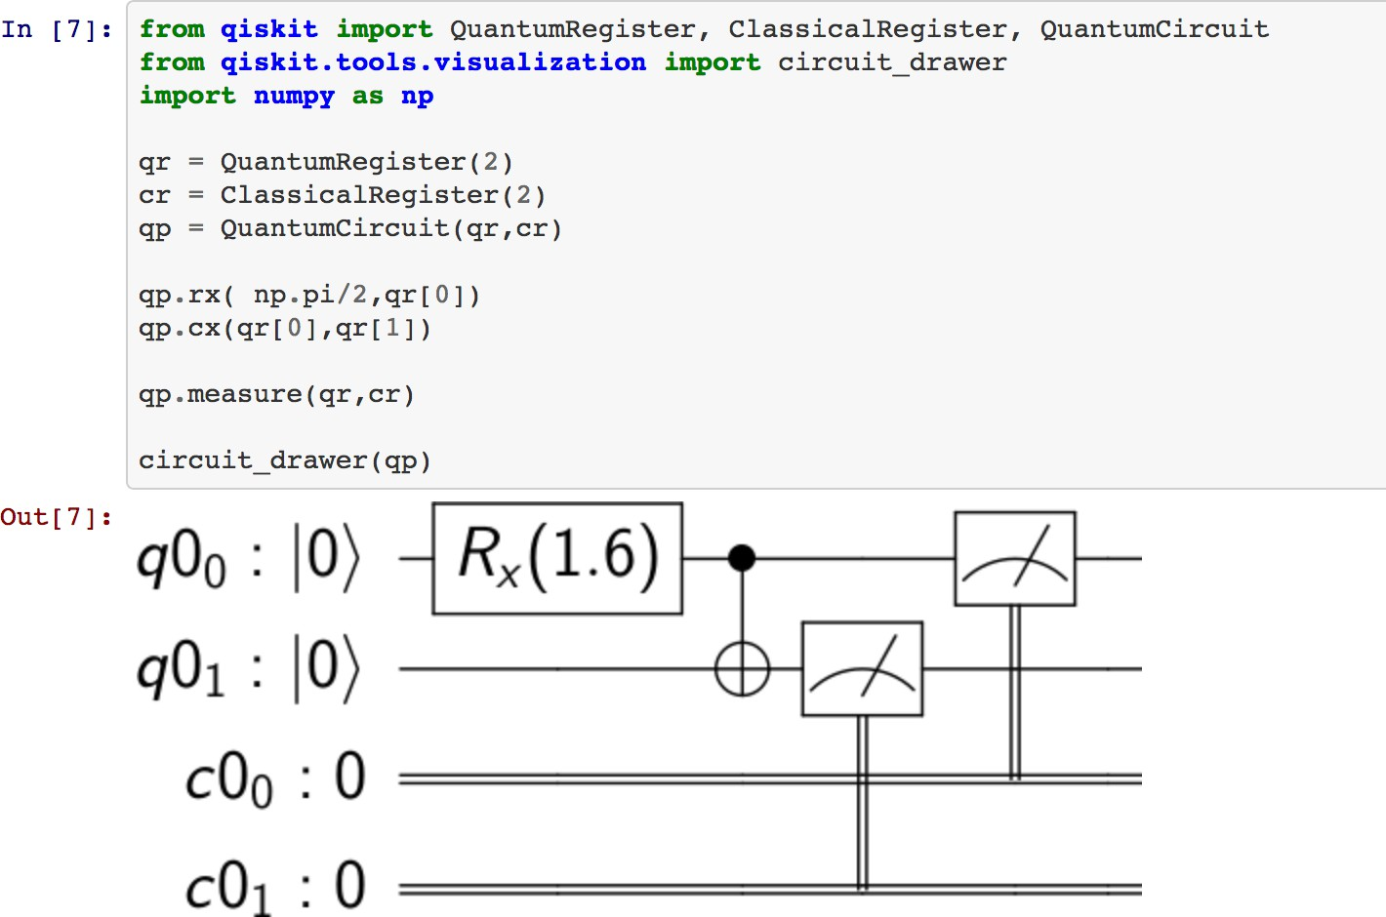
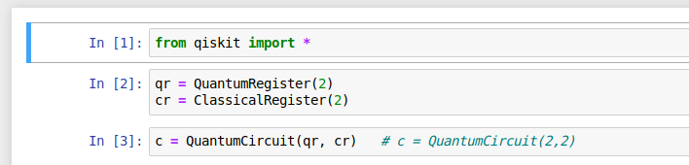
Quantum Programming
QISKit (Quantum Information Science Kit)
Qiskit is an open-source framework for quantum computing. It provides tools for creating and manipulating quantum programs and running them on prototype quantum devices on IBM Quantum Experience over Cloud-based access
Department .of Computer Science, RYMEC, Ballari

Slide 19
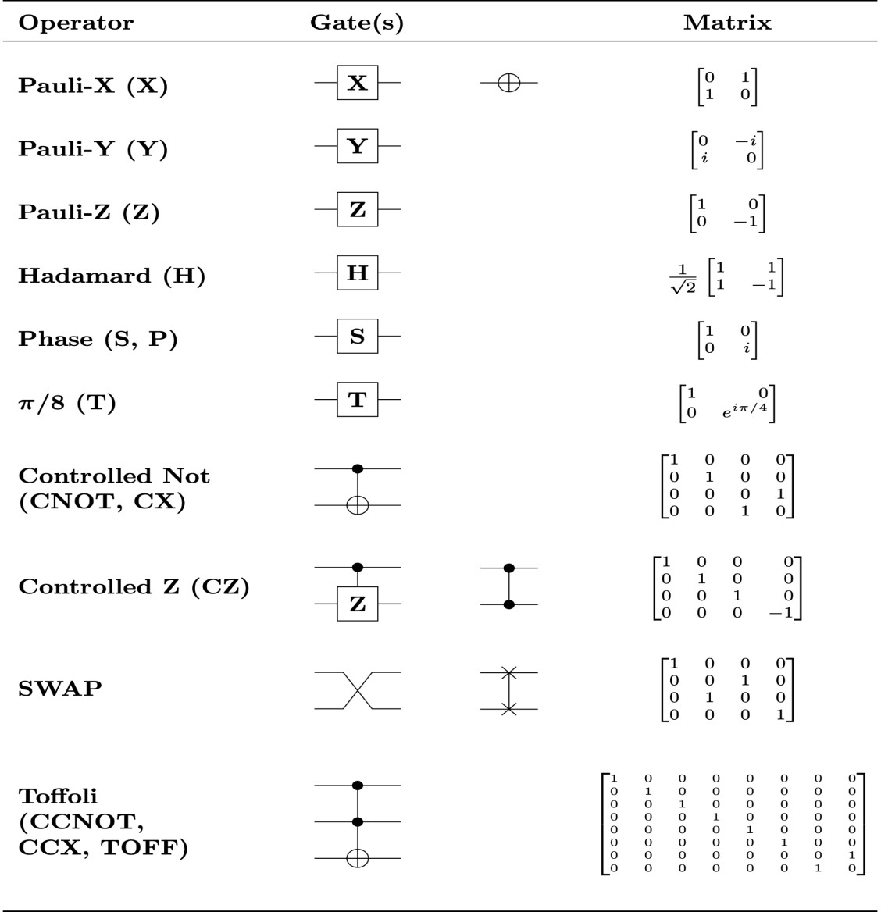

Quantum vs. Classic Gates
x | y
0 | 1
1 | 0
x | y | z
0 | 0 | 0
0 | 1 | 0
1 | 0 | 0
1 | 1 | 1
x | y | z
0 | 0 | 1
0 | 1 | 1
NOT gate
x
y = NOT(x)
AND gate
x
y
z = (x) AND (y)
NAND gate
x
y
z = (x) NAND (y)
1 0
1
 |  |  |  | 1 |  | 1 |  | 0
 |  |  |  | x |  | y |  | z
 |  |  |  | 0 |  | 0 |  | 0
 |  | z = (x) OR (y) |  | 0 |  | 1 |  | 1
 |  |  |  | 1 |  | 0 |  | 1
 |  |  |  | 1 |  | 1 |  | 1
 |  |  |  | x |  | y |  | z
 |  |  |  | 0 |  | 0 |  | 1
 |  | z = (x) NOR (y) |  | 0 |  | 1 |  | 0
 |  |  |  | 1 |  | 0 |  | 0
 |  |  |  | 1 |  | 1 |  | 0
 |  |  |  | x |  | y |  | z
 |  |  |  | 0 |  | 0 |  | 0
 |  | z = (x) XOR (y) |  | 0 |  | 1 |  | 1
 |  |  |  | 1 |  | 0 |  | 1
OR gate
x
y
NOR gate
x
y
XOR gate
x
y
Department .of Computer Science, RYMEC, Ballari

Slide 20
CODE
Language used :- Python 3.7.1
Librarie’s used :- NumPy, Qiskit, Matplotlib, pygame, time
Department .of Computer Science, RYMEC, Ballari

Slide 21
1 | 4 |  | 7 | 9 | 2 |  | 8 | 5
2 |  | 8 | 3 | 4 | 6 | 7 | 9 | 1
3 | 7 | 9 |  |  | 1 | 4 |  | 2
4 | 3 | 7 | 9 | 1 | 5 | 8 | 2
5 |  | 1 | 6 |  | 7 | 9 | 3 | 4
6 | 9 | 2 | 4 | 3 | 8 | 1 | 5 | 7
7 |  |  | 2 | 6 | 9 |  | 4 | 8
8 | 2 | 4 | 1 | 5 | 3 | 6 | 7 | 9
9 |  | 5 | 8 | 7 |  | 2 | 1 | 3
Original Puzzle
Department .of Computer Science, RYMEC, Ballari

Slide 22
1 | 4 | 6 | 7 | 9 | 2 | 3 | 8 | 5
2 | 5 | 8 | 3 | 4 | 6 | 7 | 9 | 1
3 | 7 | 9 | 5 | 8 | 1 | 4 | 6 | 2
4 | 3 | 7 | 9 | 1 | 5 | 8 | 2 | 6
5 | 8 | 1 | 6 | 2 | 7 | 9 | 3 | 4
6 | 9 | 2 | 4 | 3 | 8 | 1 | 5 | 7
7 | 1 | 3 | 2 | 6 | 9 | 5 | 4 | 8
8 | 2 | 4 | 1 | 5 | 3 | 6 | 7 | 9
9 | 6 | 5 | 8 | 7 | 4 | 2 | 1 | 3
Solved Puzzle
Department .of Computer Science, RYMEC, Ballari

Slide 23
Quantum Computing Highlights:
Google's Willow Chip: With 105 qubits, it reduces errors and solves tasks billions of times faster than classical supercomputers.
Entanglement Record: 24 logical qubits were entangled, advancing scalable, fault-tolerant quantum systems.
IBM's Progress: Focused on healthcare, climate, and materials science, IBM plans a fully error-corrected quantum system by 2029.
Department .of Computer Science, RYMEC, Ballari

Slide 24
THANK YOU
Department .of Computer Science, RYMEC, Ballari

